Slide 1
Boxin' Buddies
By
Bhanu Kirrann Garikipati
Varshin Hariharan Bhaskaran
Saurav Sundararaju Makam
IST 659 Final Project

Slide 2
TABLE OF CONTENTS
Project Overview
Project Purpose
Entity Relationship Data Requirements/Business Rules
Conceptual Data Model
User Stories
Triggers/Procedures
User Interface Design

Slide 3
PROJECT OVERVIEW
Our project, Boxin' Buddies, is a web-based application that utilizes a database management system to streamline the process of package delivery. It provides a platform for users to create, track and manage packages and connects them with travelers who can pick up and deliver their packages to their desired destinations. The system is designed to ensure secure and efficient delivery of packages, and also provides features such as package tracking, payment processing, and user ratings. Our database management system ensures reliable and efficient storage and management of data, allowing for quick access to information and smooth functioning of the system.

Slide 4
PROJECT PURPOSE
To provide a reliable and efficient platform for package delivery that connects senders with travelers.
To allow senders to easily create and track their packages through an intuitive user interface using power apps.
To enable travelers to find and accept package delivery assignments that fit their availability and preferences.
To provide a comprehensive history of transactions for both senders and travelers to track their activities and monitor the performance of the platform
Allow users to track the status of their package delivery.

Slide 5
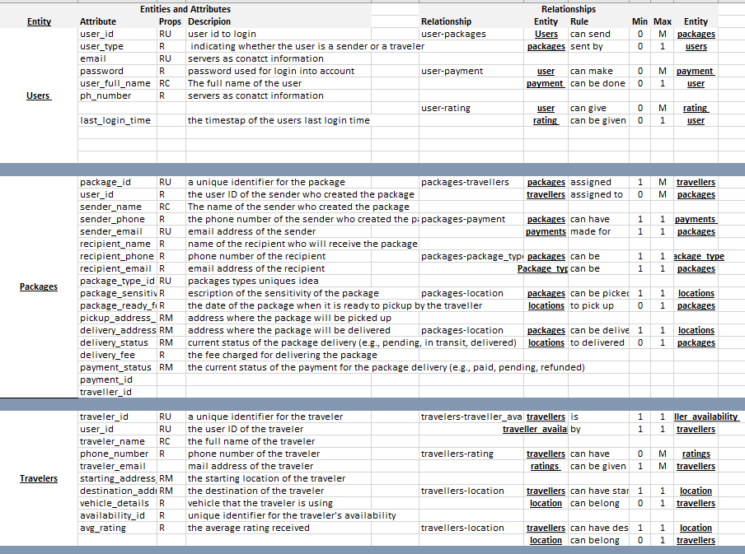
ERD DATA REQUIREMENTS/BUSINESS RULES

Slide 6
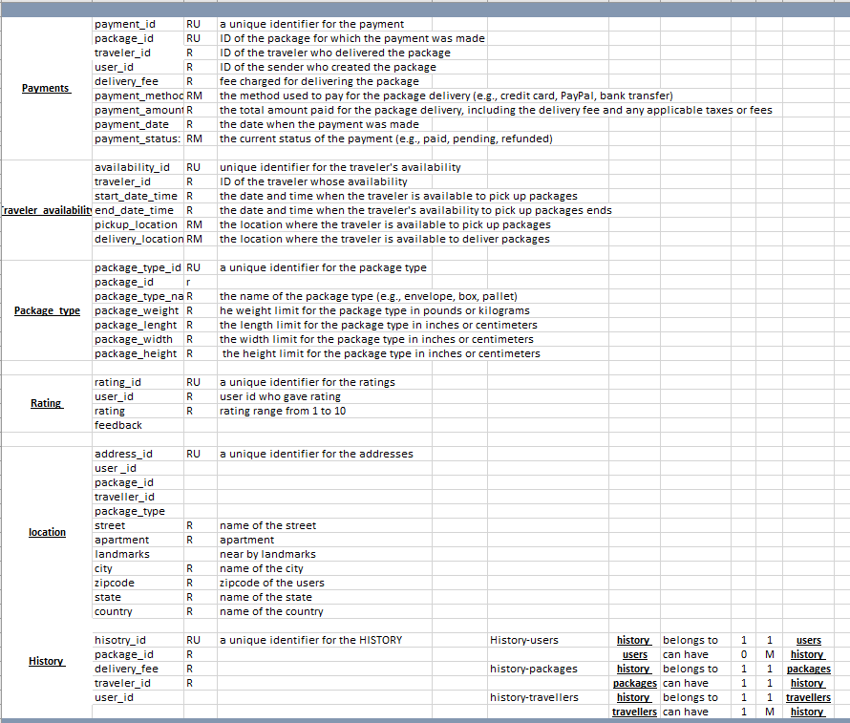

Slide 7
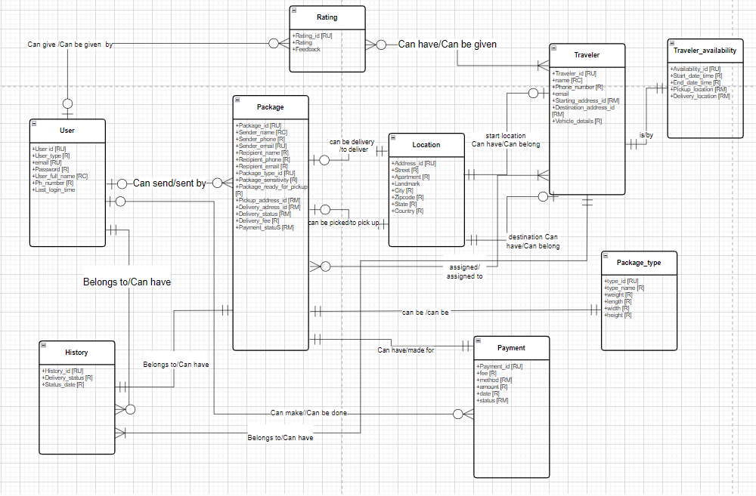
CONCEPTUAL MODEL

Slide 8

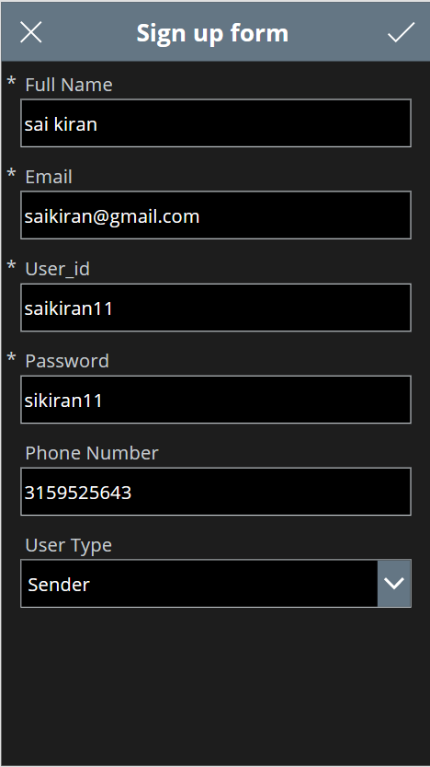
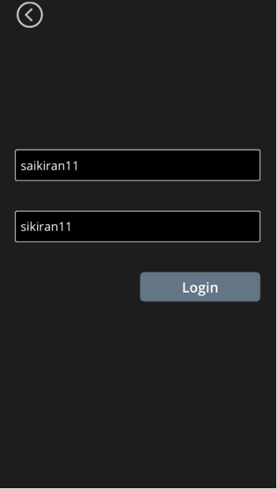
User stories
User Signup: As a user, I want to sign up for the service with my email and password to gain access to the platform.
USER INTERFACE

Slide 9
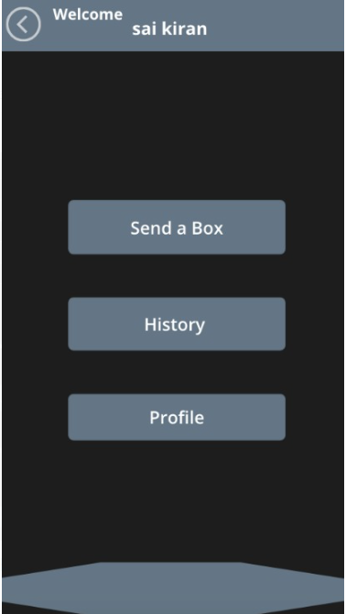
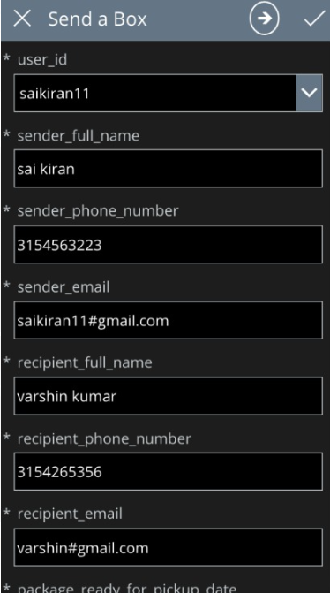
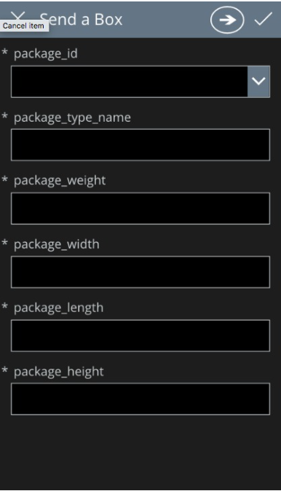
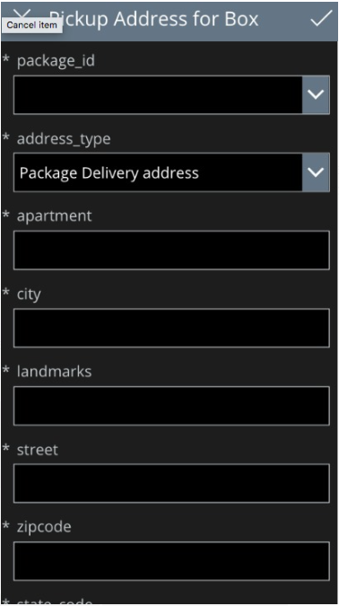
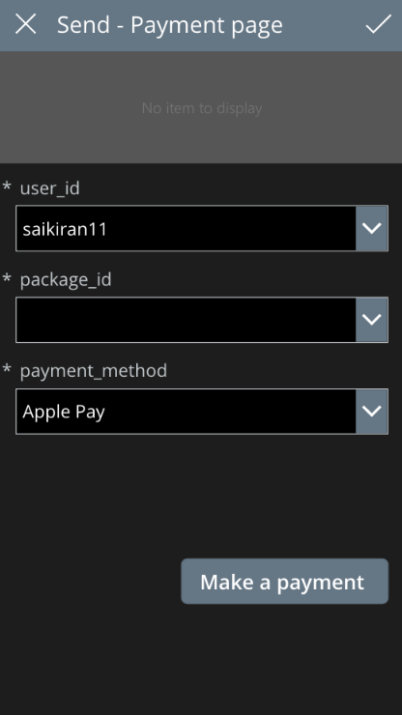
User stories
User Package Send: As a user, I want to send a package by specifying the pickup and delivery locations, recipient details, and package type, and make payment for the service.
USER INTERFACE

Slide 10
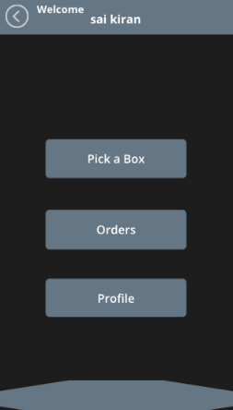
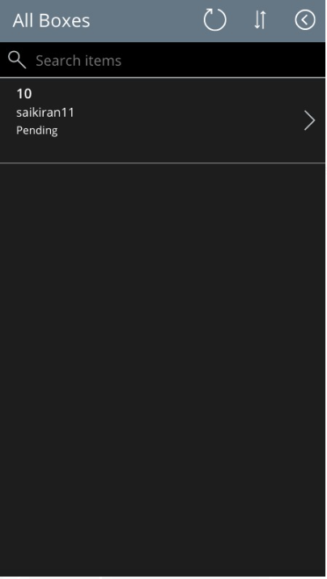
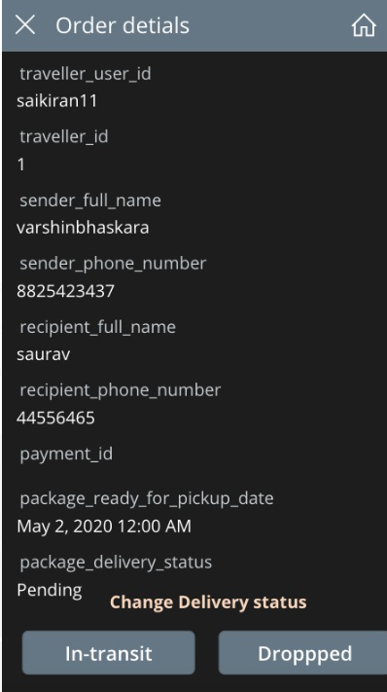
User stories
Traveller - Picking and Delivering the Box: As a traveller, I want to view available packages and their pickup and delivery locations, and accept to pick up and deliver a package to the recipient within a specified timeframe.
USER INTERFACE

Slide 11
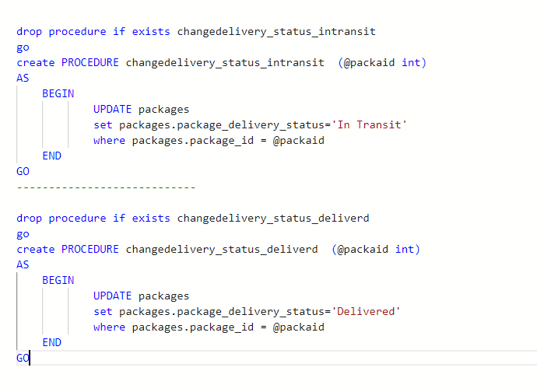
These stored procedures update the delivery status of a package to 'In Transit' or 'Delivered' respectively.

Slide 12
This trigger updates the package_delivery_status and package_payment_status fields in the packages table to 'Cancelled' if they are still 'Pending' after a specified delay (19 minutes)

Slide 13
This trigger updates the packages and payments tables after a package is inserted or updated. It sets the payment status of the package and the related payment record.

Slide 14
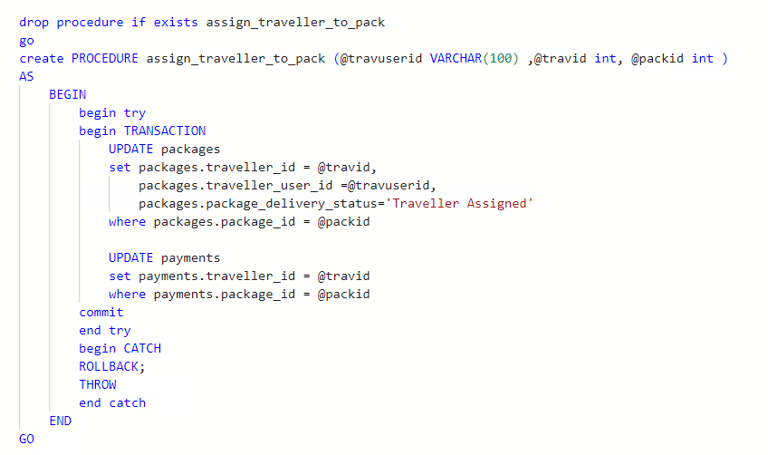
This stored procedure updates the packages and payments tables, assigning a traveller to a package and updating the package's delivery status.

Slide 15
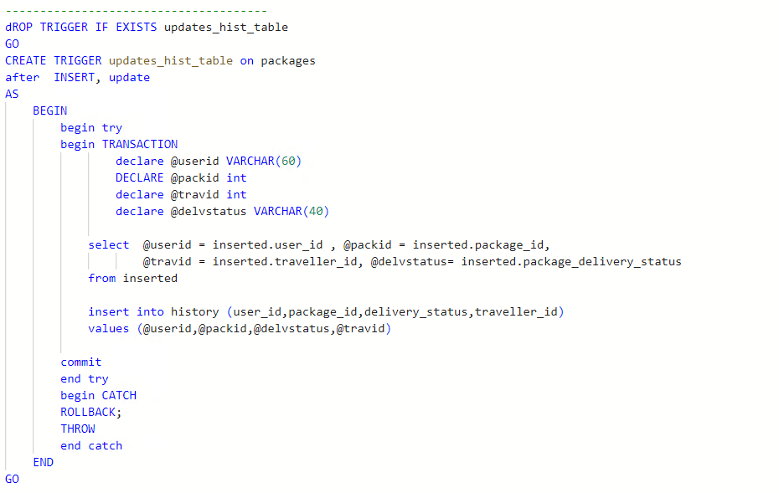
This trigger inserts a record into the history table whenever a package is inserted or updated, keeping track of package-related activities.

Slide 16
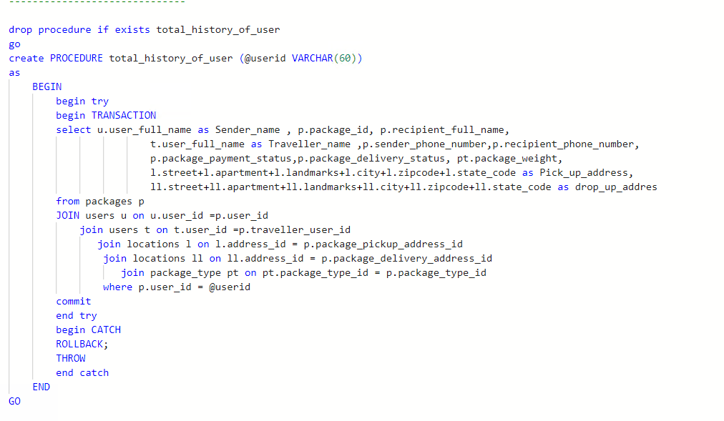
This stored procedure retrieves the complete history of a user's transactions, including package details, sender and traveller information, and addresses.

Slide 17
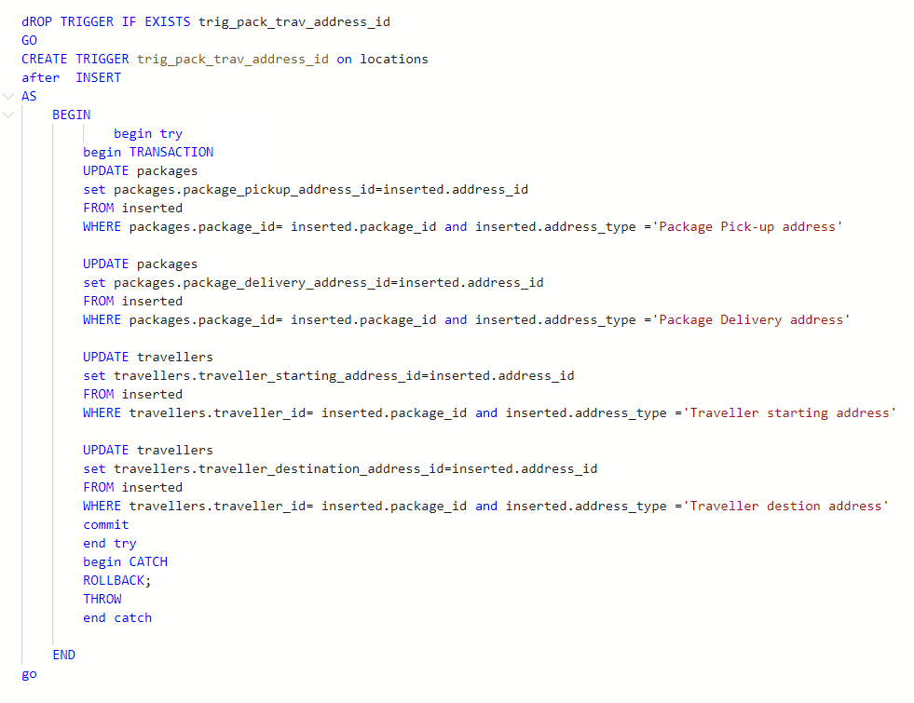
This trigger updates the packages and travellers tables with the appropriate address IDs after an address is inserted into the locations table.

Slide 18
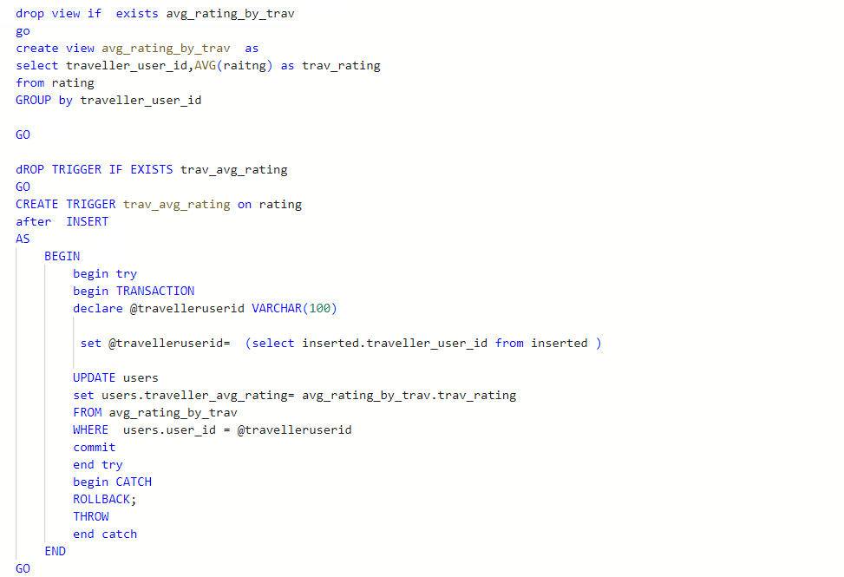
This trigger updates the users table with the average rating of a traveller after a new rating is inserted into the rating table

Slide 19
Reflections.
To provide a reliable and efficient platform for package delivery that connects senders with travelers.
To allow senders to easily create and track their packages through an intuitive user interface using power apps.
To enable travelers to find and accept package delivery assignments that fit their availability and preferences.
To provide a comprehensive history of transactions for both senders and travelers to track their activities and monitor the performance of the platform
Allow users to track the status of their package delivery.

Slide 20
THANK YOU

